Slide 1
Introduction to R

Slide 2
R
R is an implementation of a functional programming language S.
R has been developed and maintained by a core of statistical programmers, with the support of a large community.
R is free.
R is most widely used for statistical computing and graphics.
R is also a fully programming language well suited to scientific programming in general.

Slide 3
Download and install R
R is a free software environment for statistical computing and graphics.
R compiles and runs on a wide variety of UNIX, Windows and MacOS.
https://www.r-project.org/

Slide 4
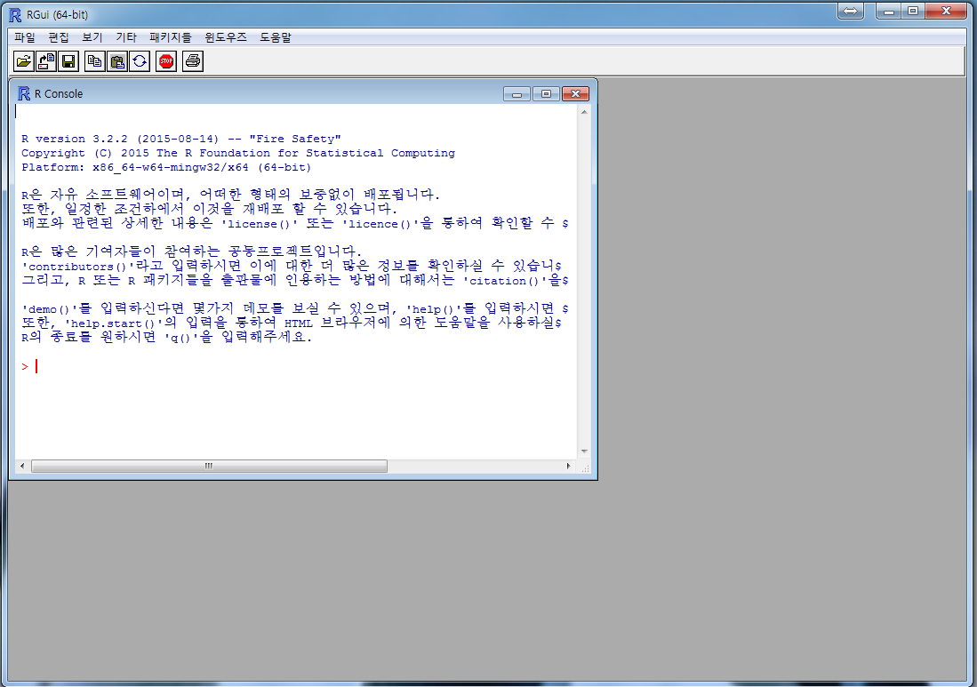
RGui

Slide 5
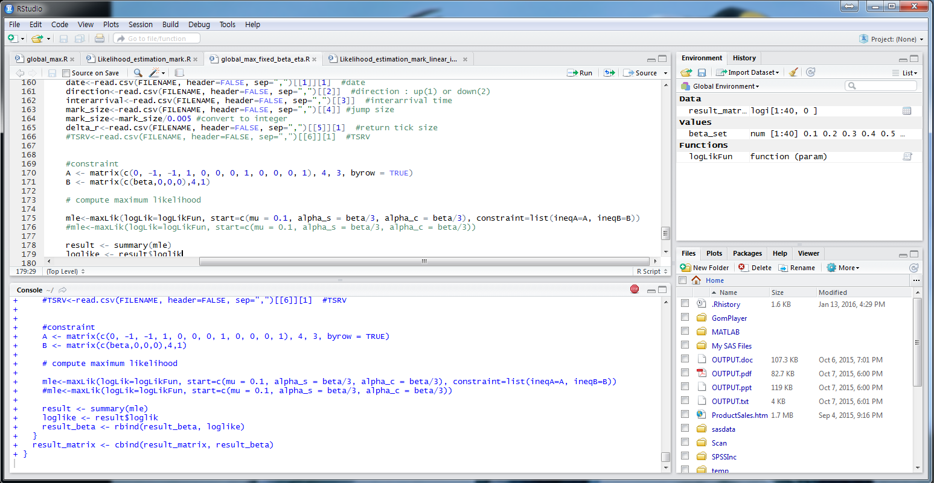
RStudio
RStudio IDE is a user interface for R.
free and open source
is not necessary but might help you

Slide 6
R: pro and cons
Pro: A picture says more than a thousands words
R and visualization are a perfect match. (ggplot2, ggvis, googleVis and rCharts.)
Pro: R ecosystem
R has a rich ecosystem of cutting-edge packages and active community.
Pro: R lingua franca of data science
R is developed by statisticians for statisticians who communicate ideas and concepts through R code and packages
Pro/Con: R is slow
Although R can be experienced as slow due to poorly written code, there are multiple packages to improve R’s performance: pqR, renjin and FastR, Riposte and many more.
Con: R has a steep learning curve
http://www.kdnuggets.com/2015/05/r-vs-python-data-science.html

Slide 7
R as a calculating environment
R can be used as a powerful calculator.
Arithmetic
> (1+1/100)^100
[1] 2.704814
> 17%%5
[1] 2
> 17%/%5
[1] 3
[1] implies this is item 1 in a vector of output.
symbols
symbol | meaning
+ | addition
- | subtraction
* | multiplication
/ | division
^ | exponential
%% | modulus
%/% | integer division

Slide 8
built-in function in R
R has a number of built in functions:
sin(x), cos(x), tan(x), exp(x), log(x), sqrt(x), floor(x), ceiling(x), round(x), …
> exp(1)
[1] 2.718282
> options(digits = 16)
> exp(1)
[1] 2.718281828459045
> pi
[1] 3.141592653589793
> sin(pi/6)
[1] 0.5

Slide 9
Variable
We can assign a value to a variable and use the variable.
For the assignment, we use command <-.
Variable names made up of letters, numbers, . or _
provided it starts with a letter, or . then a letter.
names are case sensitive.
for example,
x, y, my_variable, a1, a2, .important_variable, x.input
wrong name:
2016_income, .1grade, _x, y@gmail.com

Slide 10
Display variable
To display the value of a variable x, we type x
or print(x) or show(x).
> x <- 100
> x
[1] 100
We can show the outcome of assignment by parentheses.
> (y <- (1+1/x)^x)
[1] 2.711517

Slide 11
more about assignment
When assigning, the right-hand side is evaluated first, then that value is placed in the variable on the left-hand side.
> n <- 1
> n < n+1
> n
[1] 2
R allows the use of = for variable assignment, in common with most programming languages.

Slide 12
Functions
Takes one or more argument (inputs) and produces one or more outputs (return values).
> seq(from = 1, to = 9, by =2)
[1] 1 3 5 7 9
> seq(from = 1, to = 9)
[1] 1 2 3 4 5 6 7 8 9
You can access the built-in help by help(function name) or ?function name

Slide 13
argument name
Every function has a default order for arguments.
If you provide arguments in this order, then they do not need to be named.
> seq(1, 9, 2)
[1] 1 3 5 7 9
> seq(to = 9, from 1)
[1] 1 2 3 4 5 6 7 8 9
> seq(by=-2, 9, 1)
[1] 9 7 5 3 1

Slide 14
Vectors
indexed list of variables
the name of the i-th element of vector x is x[i]
three basic functions for constructing vectors
> (x <- seq(1, 20, by = 2))
[1] 1 3 5 7 9 11 13 15 17 19
> (y <- rep(3, 4))
[1] 3 3 3 3
> (z <- c(y, x))
[1] 3 3 3 3 1 3 5 7 9 11 13 15 17 19

Slide 15
sequence
another method for sequence
> (x <- 100:110)
[1] 100 101 102 103 104 105 106 107 108 109 110
> (y <- 110:100)
[1] 110 109 108 107 106 105 104 103 102 101 100

Slide 16
vector and index
> (x<- 100:110)
> i <- c(1, 3, 2)
> x[i]
[1] 100 102 101
> j <- c(-1, -2, -3)
> x[j]
[1] 103 104 105 106 107 108 109 110
index들이 음수로 구성된 경우, 그 index에 해당하는 값들을 제외한 나머지

Slide 17
empty vector
> x <- c()
algebraic operation : elementwise
> x <- (1, 2, 3)
> y <- (4, 5, 6)
> x*y
[1] 4 10 18
> y^x
[1] 4 25 216
with unequal length of vectors
> c(1, 2, 3, 4) + c(1, 2)
[1] 2 4 4 6
> 2 * c(1, 2, 3)
[1] 2 4 6
> (1:3)^2
[1] 1 4 9
> c(1, 2, 3) + c(1, 2)
[1] 2 4 4
but warning message
functions taking vectors
> sqrt(1:3)
[1] 1.00000 1.41421 1.73205
> mean(1:6)
[1] 3.5
> sort(c(5, 1, 3, 4, 2))
[1] 1 2 3 4 5

Slide 18
Example – mean and variance
compare computed mean and variance with built-in functions
> x <- c(1.2, 0.9, 0.8, 1, 1.2)
> x.mean <- sum(x)/length(x)
> x.mean – mean(x)
[1] 0
> x.var <- sum((x-x.mean)^2)/(length(x)-1)
> x.var – var(x)
[1] 0

Slide 19
Example – simple numerical integration
> dt <- 0.005
> t <- seq(0, pi/6, by = dt)
> ft <- cos(t)
> (I <- sum(ft) * dt)
[1] 0.5015487
> I – sin(pi/6)
[1] 0.001548651
t is a vector and ft is also a vector.
Note the difference between the numerical integration and theoretical value.

Slide 20
Example – exponential limit
> x <- seq(10, 200, by = 10)
> y <- (1 + 1/x)^x
> exp(1) – y
[1] 0.12453937 0.06498412 0.04396305 0.03321799 0.02669380
[6] 0.02231169 0.01916546 0.01679689 0.01494937 0.01346800
[11] 0.01225375 0.01124034 0.01038175 0.00964501 0.00900592
[16] 0.00844625 0.00795208 0.00751253 0.00711903 0.00676471
> plot(x, y)
plot y against x : x and y must be the vectors of the same length

Slide 21
Missing data
in R, missing data is represented by NA
> a <- NA # assign NA to variable A
> is.na(a) # is it missing?
[1] TRUE
> a <- c(11, NA, 13)
> is.na(a)
[1] FALSE TRUE FALSE
> mean(a)
[1] NA
> mean(a, na.rm = TRUE) #NAs can be removed
[1] 12

Slide 22
Expression and assignment
Expression is a phrase of code that can be executed.
> seq(10, 20, by=3)
[1] 10 13 16 19
> 4
[1] 4
> mean((c(1,2,3))
[1] 2
> 1 > 2
[1] FALSE
If the evaluation of the expression is saved using <-, then it called an assignment.
> x1 <- seq(10, 20, by=3)
> x2 <- 1>2

Slide 23
Logical expression
A logical expression is formed using
the comparison operators
<, >, <=, >=, ==, and != (not equal to)
and the logical operators
& (and), | (or), and ! (not)
The value of a logical expression is either TRUE or FALSE.
The integers 1 and 0 can also be used as TRUE or FALSE.
> c(0, 0, 1, 1) | c(0, 1, 0, 1)
[1] FALSE TRUE TRUE FALSE

Slide 24
x[subset]
We can extract a subvector using a subset as a vector of TRUE/FALSE.
> x <- 1:10
> x%%4 == 0
[1] FALSE FALSE FALSE TRUE FALSE FALSE FALSE TRUE FALSE FALSE
> ( y <- x[ x%%4==0 ] )
[1] 4 8

Slide 25
subset and which function
R also provide subset function, which ignore NA.
whereas x[subset] preserve NA.
> x <- c(1, NA, 3, 4)
> x[x >2]
[1] NA 3 4
> subset(x, subset = x>2 )
[1] 3 4
For the index position of TRUE elements, use which(x)
> x <- c(1, 1, 2, 3, 5, 8 13)
> which(x%%2 == 0)
[1] 3 6

Slide 26
Example : rounding error
Many floating numbers are subject to rounding errors in digital computers.
> 2*2 == 4
[1] TRUE
> sqrt(2)*sqrt(2) == 2
[1] FALSE
The solution is to use all.equal(x,y), which returns TRUE if the difference between x and y is smaller than some tolerance.
> all.equal(sqrt(2)*sqrt(2), 2)
[1] TRUE

Slide 27
Matrix
Matrix is created from a vector using the function matrix:
matrix(data, nrow =1, ncol=1, byrow=TRUE)
data : vector of length at most nrow*ncol
if length of vector< nrow*ncol, then data is reused as many times as is needed
nrow : number of rows
ncol : number of columns
byrow = TRUE : fill the matrix up row-by-row
byrow = FALSE : fill the matrix up column-by-column, default
diag(x) : create diagonal matrix
rbind(…) : join matrices with rows of the same length
cbind(…) : join matrices with columns of the same length

Slide 28
Matrix example
> (A <- matrix(1:6, nrow=2, ncol=3, byrow=TRUE))
[,1] [,2] [,3]
[1,] 1 2 3
[2,] 4 5 6
> A[1, 3] <- 0
> A[, 2:3]
[,1] [,2]
[1,] 2 0
[2,] 5 6
> (B <- diag(c(1,2,3)))
[,1] [,2] [,3]
[1,] 1 0 0
[2,] 0 2 0
[3,] 0 0 3

Slide 29
Matrix operation
Usual algebraic operations, including *, act elementwise.
To perform matrix operation, we use %*%.
nrow(x), ncol(x)
det(x) : determinant of x
t(x) : transpose of x
solve(A, B) : returns x such that A %*% x = B
If A is invertable, the solve(A) is the inverse of A.

Slide 30
Matrix operation (2)
> A <- matrix(c(3,5,2,3), nrow=2, ncol=2)
> B <- matrix(c(1,1,0,1), nrow=2, ncol=2)
> A %*% B
> A.inv < solve(A)
> A %*% A.inv # we observe rounding error
[,1] [,2]
[1,] 1 -8.881784e-16
[2,] 0 1.000000e+00
> A^(-1) #This is not an inverse. ^(-1) applies elementwise.

Slide 31
Workspace
The objects that you create using R remain in existence until you explicitly delete them.
rm(x) : remove object x
rm(list=ls()) : remove all objects

Slide 32
Working directory
When you run R, it uses one of the directories on your hard drive as a working directory,
where it looks for user-written programs and data files.
getwd()
check the working directory.
setwd("dir")
change the working directory to "dir"
혹은 파일->작업 디렉터리 변경을 이용
/ for directory and file address, . refers current directory, .. refers parent directory

Slide 33
Writing scripts
We can type and evaluate all possible R expression at the prompt, it is much more convenient to write scripts,
which simply comprise collections of R expression.
We use the terms program and code synonymously with script.
You can use built-in editor in Rgui or Rstudio.
or text-editor like Tinn-R, emacs

Slide 34
Help
To find out more about an R command or function x, you can type help(x) or just ?x.
If you cannot remember the exact name, then help.search("x").
HTML help command : help.start()

Slide 35
package
R provides various useful packages to help you.
https://cran.r-project.org/web/packages/
To install a package
> install.packages("packagename")
To access the package
> library("packagename")
Rgui의 '패키지들' 메뉴를 이용할 수 있음

